Slide 1
CPSC 4420 Project Slides
By Alexander Facey

Slide 2

Object Detection for SLAM – Project Task 1
Goal: Develop a program that performs real-time object detection using the laptop webcam
Purpose: Object detection is a core component of SLAM – it helps the system identify and avoid obstacles while mapping the environment
Expected Output: A live camera feed with bounding boxes drawn around detected objects

Slide 3

Tools and Framework Used
Programming Language: Python
Libraries:
OpenCV – for camera input and image display
MobileNet-SSD – for real-time object detection
Hardware: Laptop webcam
Why MobileNet-SSD?
- Easy to implement
- Fast and accurate for real-time detection
- Works well without heavy CPU/GPU requirements

Slide 4
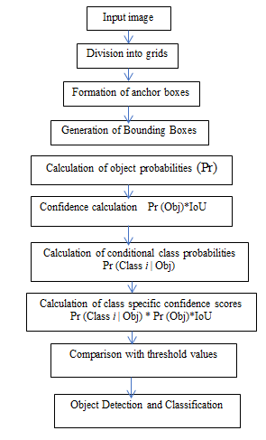
Method and Workflow
Capture live video feed from webcam using cv2.VideoCapture()
Pass each frame to MobileNet-SSD model for processing
Model detects objects and returns bounding box coordinates
Draw bounding boxes using OpenCV’s cv2.rectangle()
Display the annotated video stream in real time

Slide 5
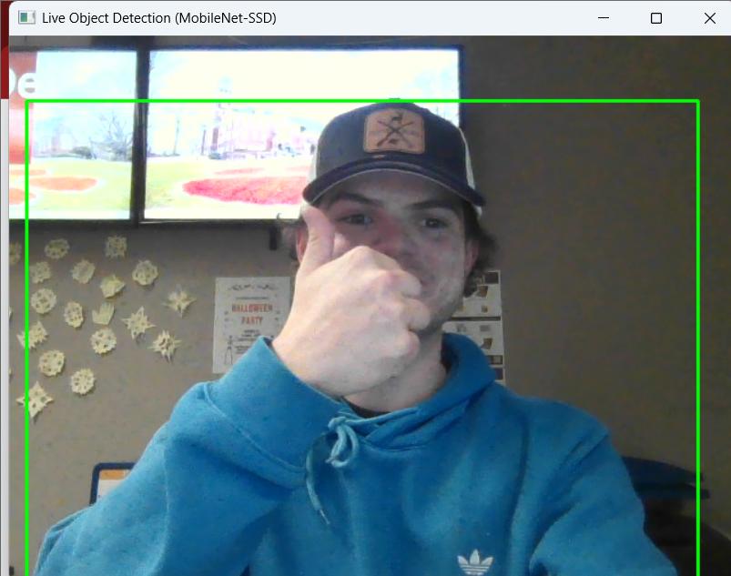
Live Demonstration
Run the application: object_detection.exe
The webcam feed will appear with bounding boxes around the detected objects
Press ‘ESC’ to exit the live feed
Notes:
Visual Suggestion:
Add a live demo screenshot or short clip frame (showing bounding boxes)

Slide 6
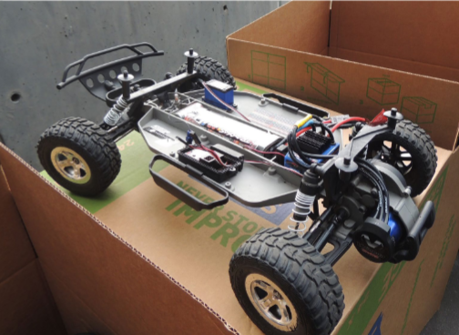
Integration with the RC Car and SLAM
Object detection will help the RC car:
Identify obstacles in real-time
Avoid collisions during navigation
Support the SLAM algorithm in mapping objects and paths
Next Step: Combine this detection system with path-planning (A*, Q-Learning) to enable autonomous navigation

